Slide 1
Capstone Project - Car accident severity
M. Bruggeling
September 28, 2020

Slide 2
Table of contents
Introduction
Data
Methodology
Results
Conclusion

Slide 3
introduction
Background
Seventy-seven percent of smartphone owners use navigation apps like Google Maps or Waze regularly to reach their destination. Navigation apps are so popular because they make navigating more convenient and help save time and resources by actively guiding the user along the quickest route. However, despite their benefits, navigation apps may also have negative impacts.

Slide 4
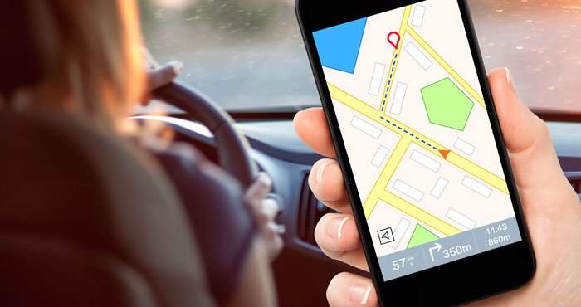
introduction
Problem
Experts have indicated that users can end up not only following the quickest route but potentially also a more dangerous route when blindly relying on their navigation apps. Consequently, accidents and serious injury may occur.

Slide 5
introduction
Interest
To provide a solution for this issue and attract new users, an undisclosed navigation app is interested in offering the safest route option. When this option is selected, a prediction is made about where injury causing accident are more likely to occur given the junction type, road, weather, and light conditions. Subsequently, these areas can be circumvented.

Slide 6
data
(In)dependent variables
'JUNCTIONTYPE': shows the type of junction where a collision happened (e.g. ‘at intersection’).
'ROADCOND': indicates the condition of the road at the time of collision (e.g. wet).
'LIGHTCOND': represents the light conditions when a collision occurred (e.g. ‘dark - street lights on’).
'WEATHER': describes the weather conditions at the time of collision (e.g. overcast).
'SEVERITYCODE': indicates whether an accident is injury causing (category 2) or an accident with property damage only (without injury) (category 1).

Slide 7
data
Pre-processing
Three pre-processing steps were taken:
Remove rows with missing values
Change dependent variable categories 1 and 2 to values 0 and 1
Convert categories in independent variables to separate indicator variables (i.e. dummy variables)

Slide 8
methodology
Variable | Count 0 | Count 1
SEVERITYCODE | 126527 | 56669
JUNCTIONTYPE_At Intersection (but not related to intersection) | 181139 | 2057
JUNCTIONTYPE_At Intersection (intersection related) | 121955 | 61241
JUNCTIONTYPE_Driveway Junction | 172676 | 10520
JUNCTIONTYPE_Mid-Block (but intersection related) | 160843 | 22353
JUNCTIONTYPE_Mid-Block (not related to intersection) | 96340 | 86856
JUNCTIONTYPE_Ramp Junction | 183034 | 162
JUNCTIONTYPE_Unknown | 183189 | 7
ROADCOND_Dry | 60930 | 122266
ROADCOND_Ice | 182017 | 1179
ROADCOND_Oil | 183136 | 60
ROADCOND_Other | 183073 | 123
ROADCOND_Sand/Mud/Dirt | 183129 | 67
ROADCOND_Snow/Slush | 182216 | 980
ROADCOND_Standing Water | 183087 | 109
ROADCOND_Unknown | 171542 | 11654
ROADCOND_Wet | 136438 | 46758
LIGHTCOND_Dark - No Street Lights | 181733 | 1463
LIGHTCOND_Dark - Street Lights Off | 182038 | 1158
LIGHTCOND_Dark - Street Lights On | 135603 | 47593
LIGHTCOND_Dark - Unknown Lighting | 183185 | 11
LIGHTCOND_Dawn | 180742 | 2454
LIGHTCOND_Daylight | 69224 | 113972
LIGHTCOND_Dusk | 177415 | 5781
LIGHTCOND_Other | 182985 | 211
LIGHTCOND_Unknown | 172643 | 10553
WEATHER_Blowing Sand/Dirt | 183147 | 49
WEATHER_Clear | 74033 | 109163
WEATHER_Fog/Smog/Smoke | 182638 | 558
WEATHER_Other | 182447 | 749
WEATHER_Overcast | 155988 | 27208
WEATHER_Partly Cloudy | 183191 | 5
WEATHER_Raining | 150518 | 32678
WEATHER_Severe Crosswind | 183171 | 25
WEATHER_Sleet/Hail/Freezing Rain | 183084 | 112
WEATHER_Snowing | 182314 | 882
WEATHER_Unknown | 171429 | 11767
Data exploration

Slide 9
methodology
Machine learning algorithms
Because the aim is to classify locations as potentially injury causing or not (property damage only) a classification algorithm is used. Multiple classification algorithms were applied: K-Nearest Neighbors (KNN), Support Vector Machine (SVM), Logistic Regression, (LR) and Decision Tree (DT).

Slide 10
methodology
Evaluation
First, the dataset was split in a train (80%) and test set (20%). Next, each algorithm was trained, tested, and evaluated using the Jaccard, LogLoss, and F1-scores.

Slide 11
methodology
Application
The best performing model was applied to predict and map injury causing accident locations using the test data.

Slide 12
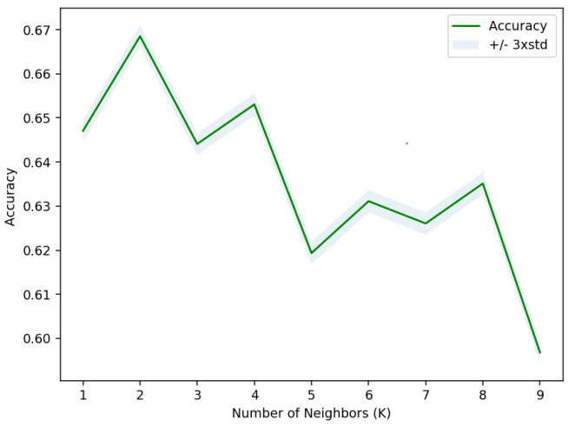
results
Accuracy of K Nearest- Neighbor model for different numbers of neighbors

Slide 13
results
Model performance evaluation
Algorithm | Jaccard | F1-score | LogLoss
KNN | 0.66853 | 0.58771 | na
Decision Tree | 0.68835 | 0.56128 | na
SVM | 0.68835 | 0.56133 | na
LogisticRegression | 0.68835 | 0.56128 | 0.58822

Slide 14
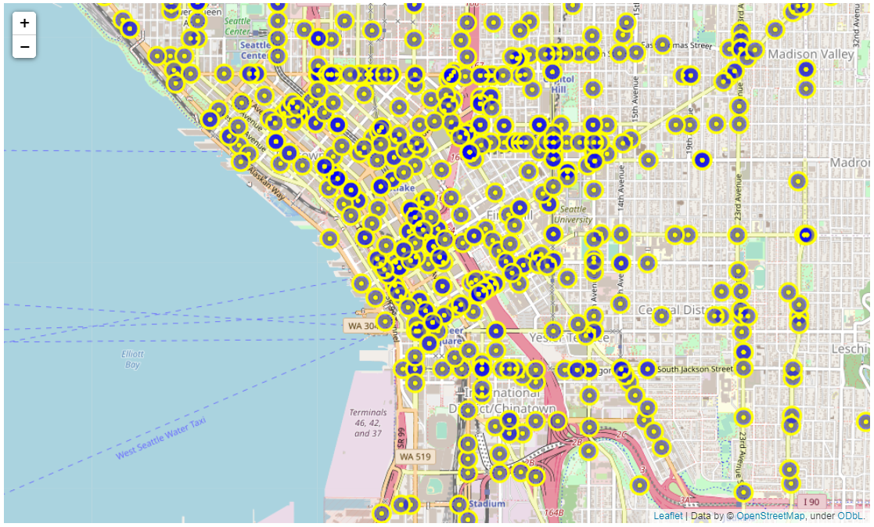
results
Predicted injury causing accident locations in a part of Seattle

Slide 15
Conclusion
Using a KNN model, a navigation app can determine where injury causing accidents may occur with a success rate of 58.77-66.85%. These locations can be predicted in advance of a user’s drive by collecting and preparing infrastructural information (road conditions and junction types) and combining it with the expected light and weather conditions (forecast) along potential routes. It follows that, by offering a route that circumvents these location, the safest route option can be found.

Slide 16
Thank YOU And stay safe!

